Slide 1
Introduction to TTT4275 Estimation, Detection and Classification (EDC)

Slide 2
Responsible persons
Lecturers :
Magne H. Johnsen - mhj@iet.ntnu.no
Course assistants :
Cristiano Gratton - cristiano.gratton@ntnu.no
Victor Håkansson - victor.haakansson@ntnu.no
Student assistants :
Torjus Haukom - torjuh@stud.ntnu.no
Halvor Horvei - halvho@stud.ntnu.no
Reference group
? ?

Slide 3
Lectures and exercises
Lectures :
Monday 10.15 - 12.00 GL-GA F2 (Old Physics building 2nd floor)
Monday 16.15 - 18.00 GL-GA F6 (Old Physics building 2nd floor)
Friday 8.15 - 10.00 GL-RFB R10 (Realfagsbygget R10 5th floor)
Exercise :
Voluntary exercises
Possible supervison : Monday 16.15-18
Project :
Supervison instead of lectures (same place/time)
More info later today!

Slide 4
Why is this (nearly) new course introduced?
Humans are frequently using EDC every day
The importance of machine based EDC is increasing for every year
Based on fast improvements in sensors, hardware and algorithms
EDC mimics humans for signals ‘’measured’’ by humans
Sound, view, smell, taste, feel/sense, …
EDC is also applied for signals not sensed by humans
Seismics, radar/sonar, ultrasound, communication, non-destructive testing …
This course shall give you the necessary EDC-platform for a variety of 4th and 5th year courses.
A mix of basic theory, a few examples and exercises.
The course ends with a group based project task

Slide 5
The estimation structure/content
Definition of estimation
Finding approximate values of unobserved signals/parameters based on observed/measured signals (in noise)
Estimator : the estimation rule/formula
Estimate : the outcome when signals are applied to an estimator
Estimation can be applied as :
A goal in it self (e.g. range estimation)
To find parameters in systems (e.g. models, detection and/or classification)
Different estimators and quality evaluation:
MVU and CRLB
Linear problem models including BLUE
Maximum Likelihood (ML) method
Bayesian estimation and the MAP method

Slide 6
Applications of estimation
Astronomy
GNSS
Medical Ultrasound
Notes:
Radar: send out a signal and monitor received signal. If the transmitted signal hits a target, it will bounce back and be picked up by the receiver after some delay. This delay will be related to the distance to the target. In practice, the received signal will be a noisy signal. Based on the received signal we are interested to decide between the two possible outcomes: 1) there is only noise received (no object), or; 2) there is a target present. Contrasting to estimation, where are concerned about acquiring a good estimate of the delay, we are here only concerned by deciding between the two outcomes. Since we have noisy observations, we will have to live with the fact of making decision errors. Our task is to have those errors under control.
Binary communication: here we transmit information across a wireless channel. The receiver is to detect which waveform (corresponding to ‘0’ or ‘1’) that was transmitted. Comparing to radar example we can make decision errors, however, any error is considered to be equally harmful in the information decoding process.
A final example relates to medical diagnosis, which gives intuition to the tradeoffs involved in detection: Failing to detect a malignant tumor is highly undesirable as it can be fatal, while too frequent flagging of a benign one (as malignant) induces unnecessary medical cost and treatment. However, we tend to prefer healthy and long life so the annoyance of going through extra treatments (or medical tests extra) is considered worthwhile. In summary. it is desirable to try to control the errors of falsely reassuring messages to patients and physicians that the disease is absent, when it is actually present.

Slide 7
The detection structure/content
Definition of detection :
Interesting object is typically rare/seldom
Detector : the rule/formula
Decision : Yes/No
Detection terms and methods :
Hypothesis testing (H0 and H1 models)
LLR testing
Bayes, MAP and Neyman Pearson detectors
Matched Filter
Linear models
How to design/estimate parameters in a detector system
How to measure and present performance:
False alarm and missed detection
ROC and DET

Slide 8
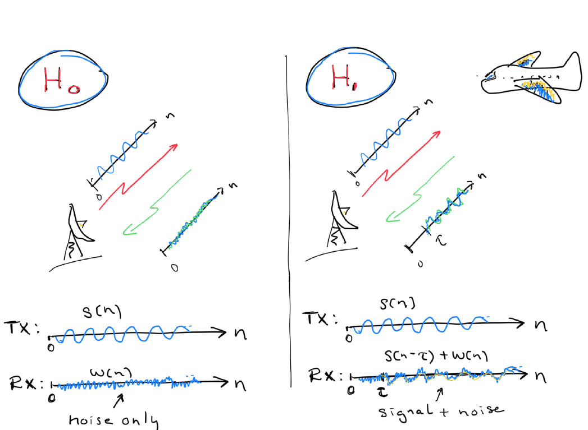
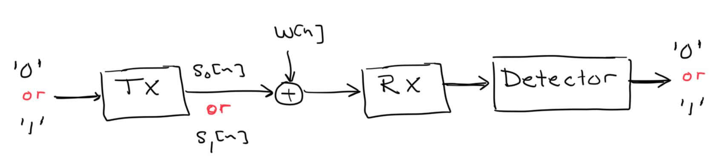
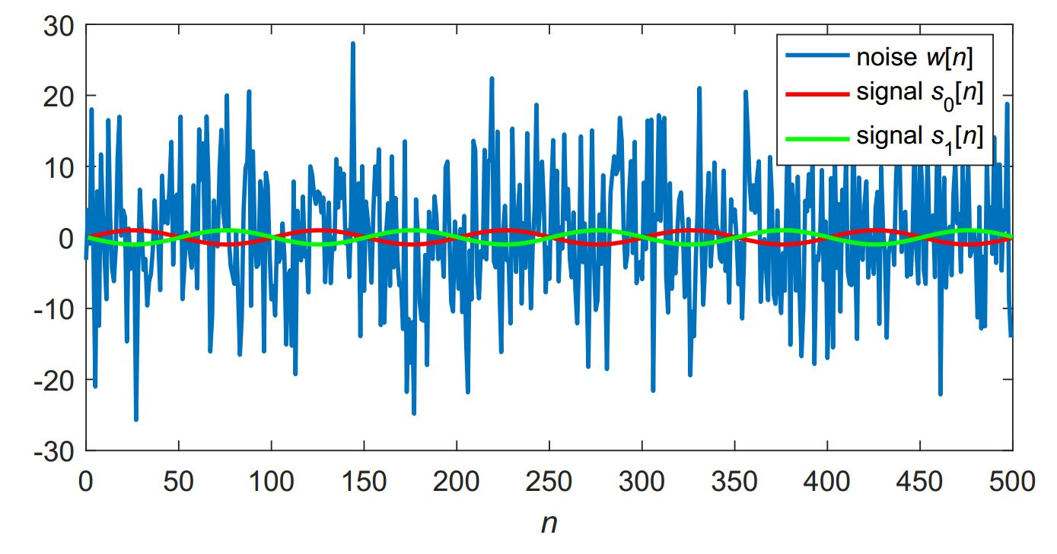
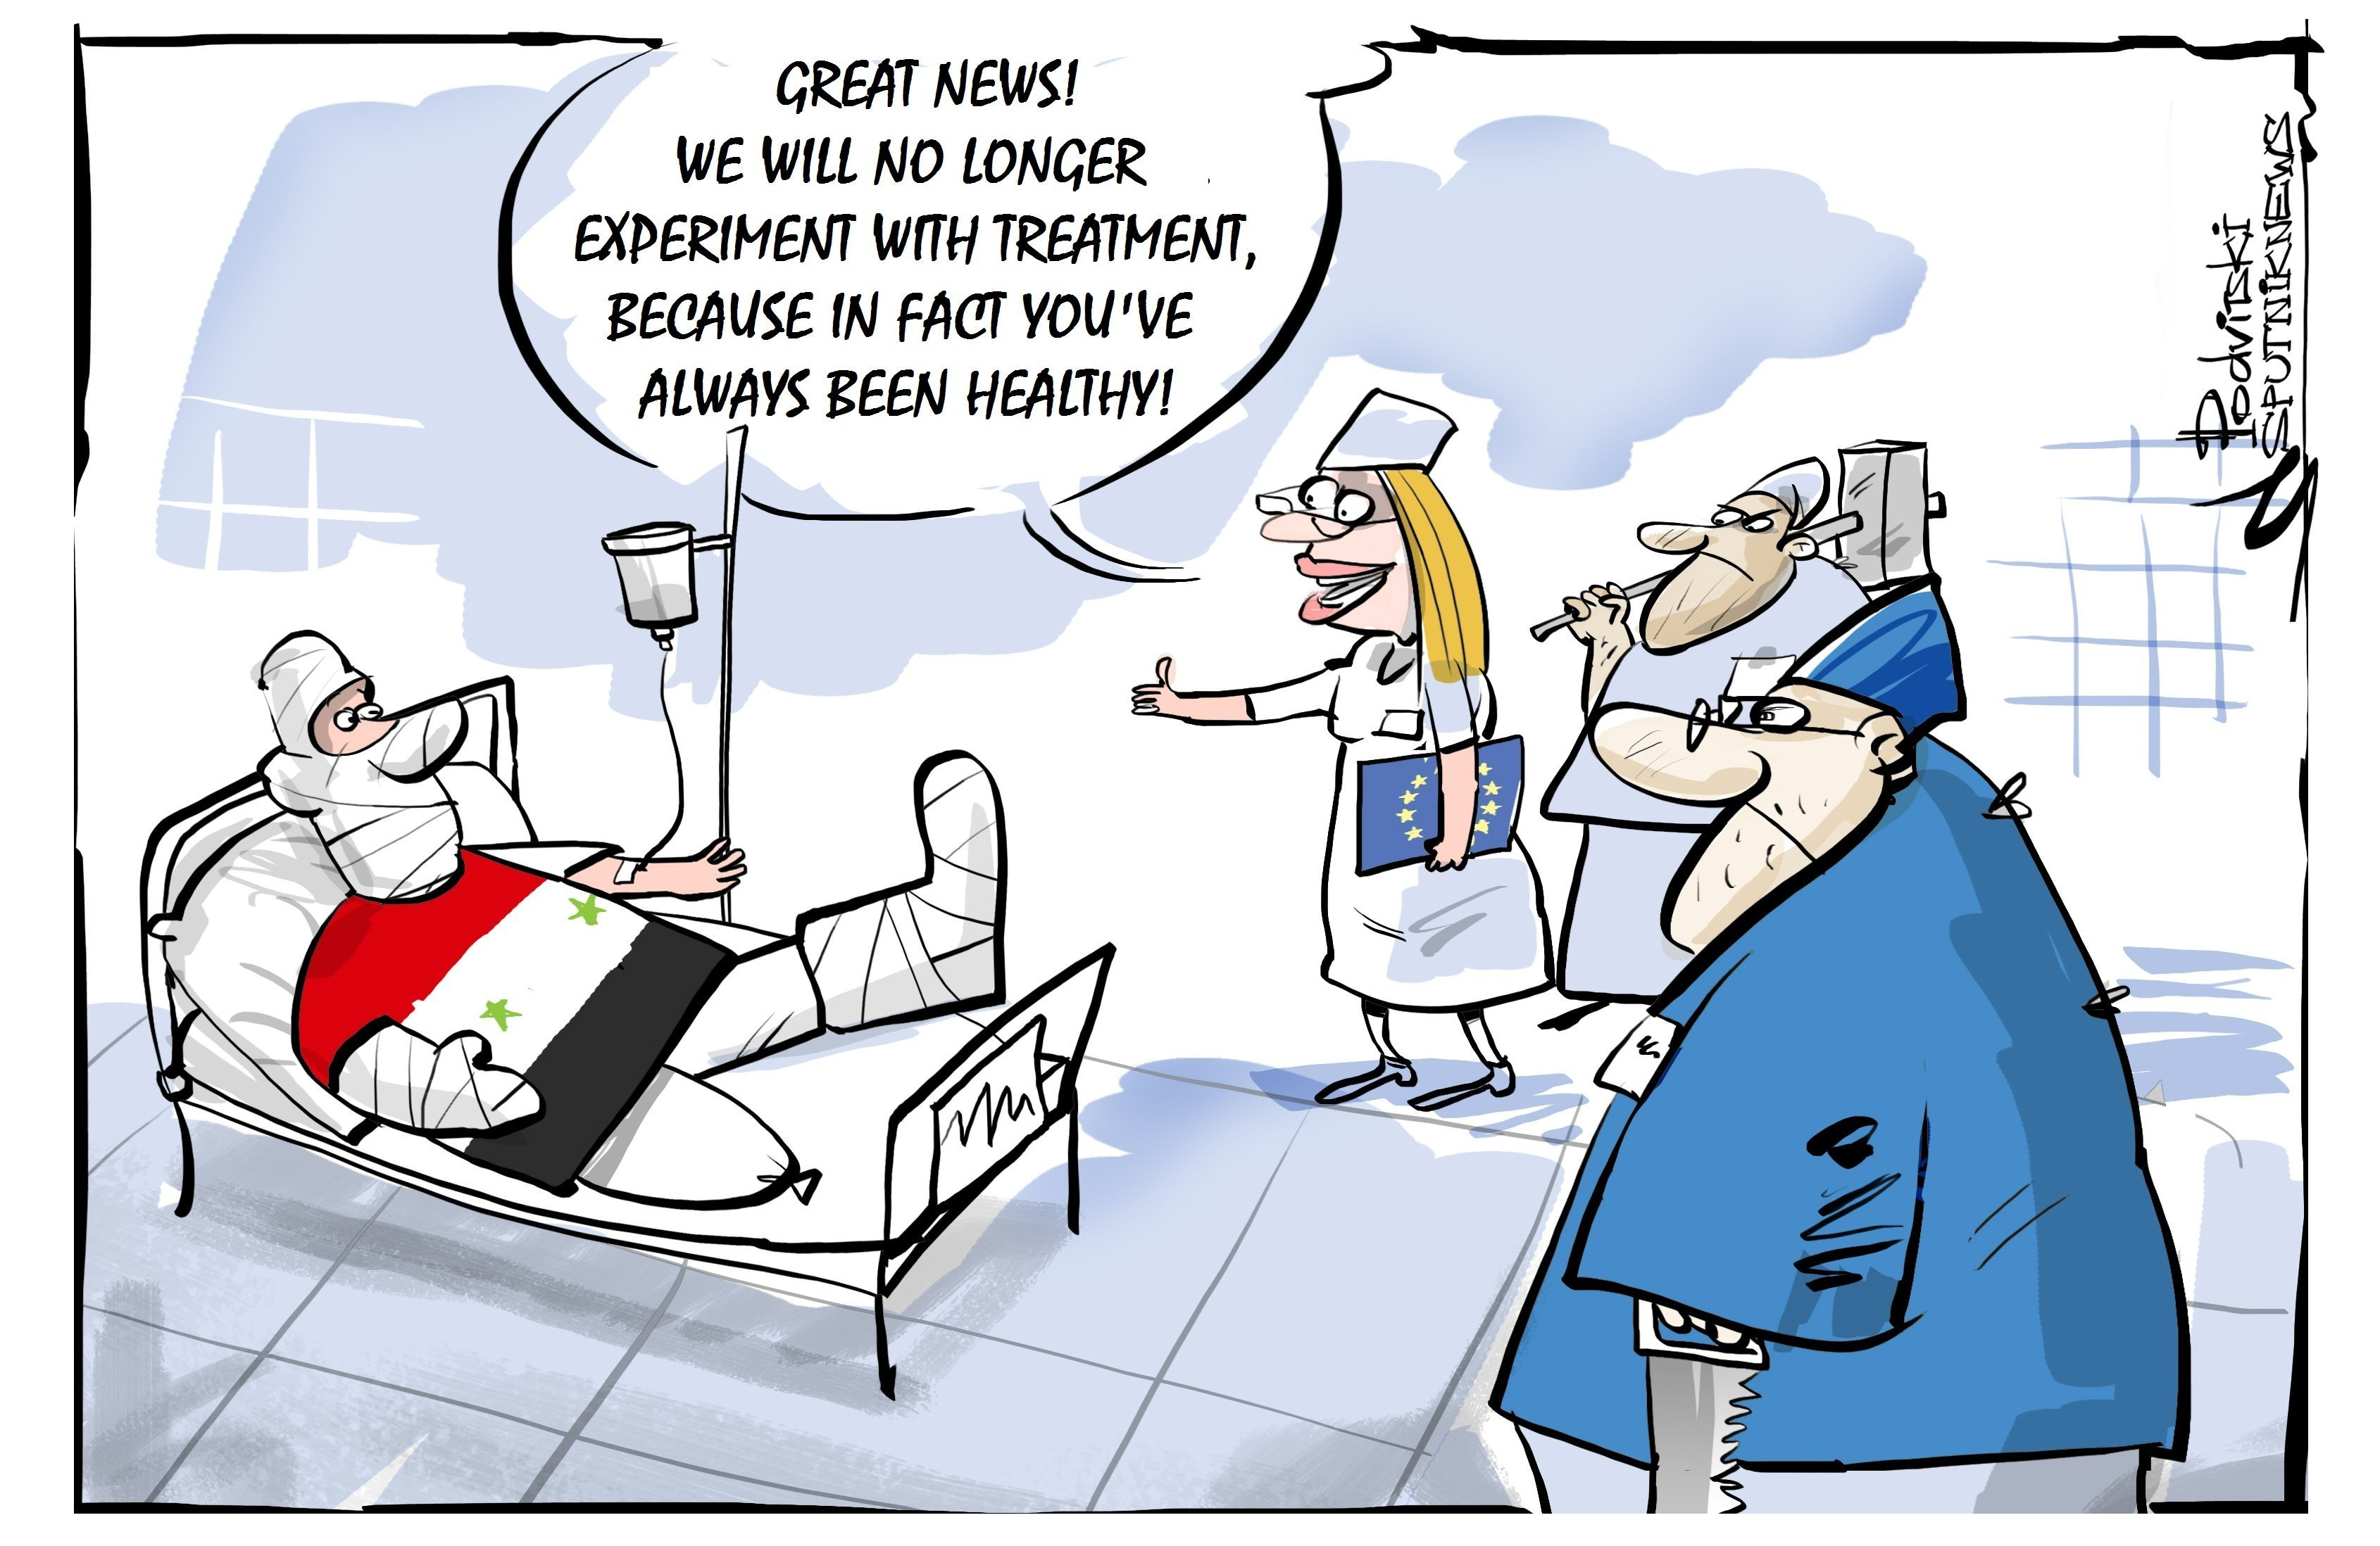
Applications of detection
Radar
Communication system
Medical diagnosis
Notes:
Radar: send out a signal and monitor received signal. If the transmitted signal hits a target, it will bounce back and be picked up by the receiver after some delay. This delay will be related to the distance to the target. In practice, the received signal will be a noisy signal. Based on the received signal we are interested to decide between the two possible outcomes: 1) there is only noise received (no object), or; 2) there is a target present. Contrasting to estimation, where are concerned about acquiring a good estimate of the delay, we are here only concerned by deciding between the two outcomes. Since we have noisy observations, we will have to live with the fact of making decision errors. Our task is to have those errors under control.
Binary communication: here we transmit information across a wireless channel. The receiver is to detect which waveform (corresponding to ‘0’ or ‘1’) that was transmitted. Comparing to radar example we can make decision errors, however, any error is considered to be equally harmful in the information decoding process.
A final example relates to medical diagnosis, which gives intuition to the tradeoffs involved in detection: Failing to detect a malignant tumor is highly undesirable as it can be fatal, while too frequent flagging of a benign one (as malignant) induces unnecessary medical cost and treatment. However, we tend to prefer healthy and long life so the annoyance of going through extra treatments (or medical tests extra) is considered worthwhile. In summary. it is desirable try to control the errors of falsely reassuring messages to patients and physicians that the disease is absent, when it is actually present.

Slide 9
The classification structure/content
Definition of classification
Classification versus detection …?
Static versus dynamic problems
Classification methods :
Theoretically optimal (MAP) classifier
Plug-in-MAP classifier (Gaussian)
Linear classifier
Template/reference based classifier
State-of-the-art classifiers
How to estimate parameters in a classifier system
How to measure and present performance
Error rate(s)
Confidence and generalization
Confusion matrix

Slide 10
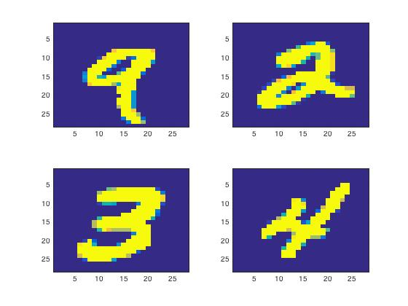
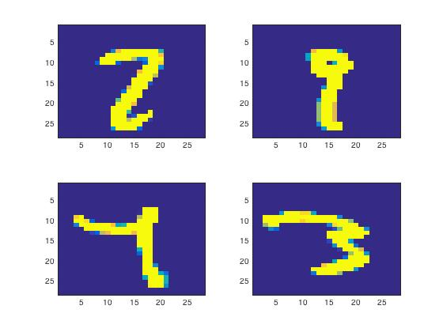
Classification example – handwritten numbers, same background
Easy for humans
Easy for classifier
Stilll easy for humans?
But difficult for (some)
classifiers

Slide 11
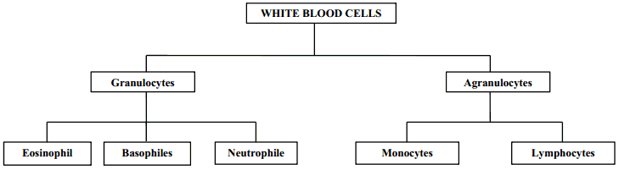
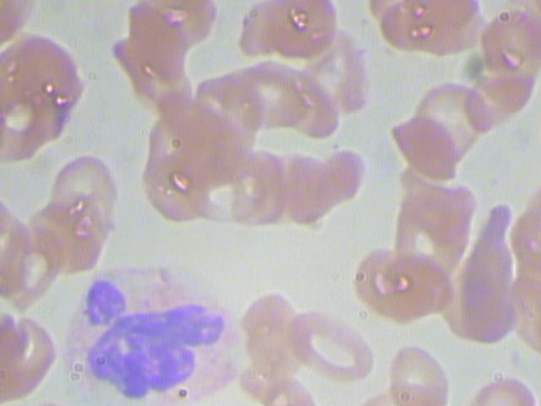
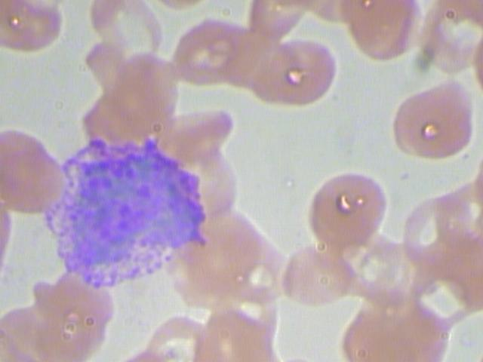
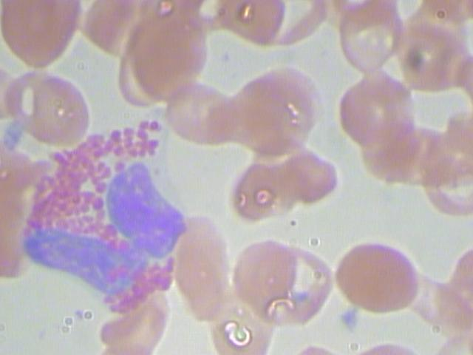
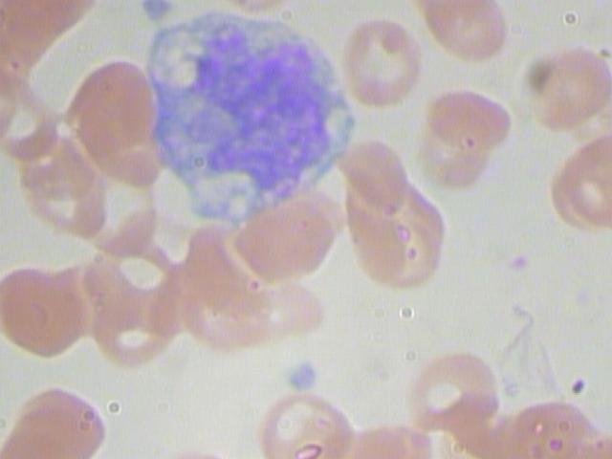
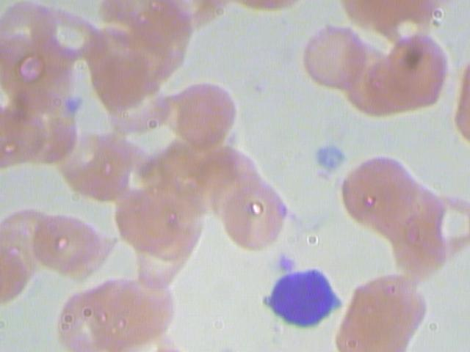
White blood cell categories

Slide 12
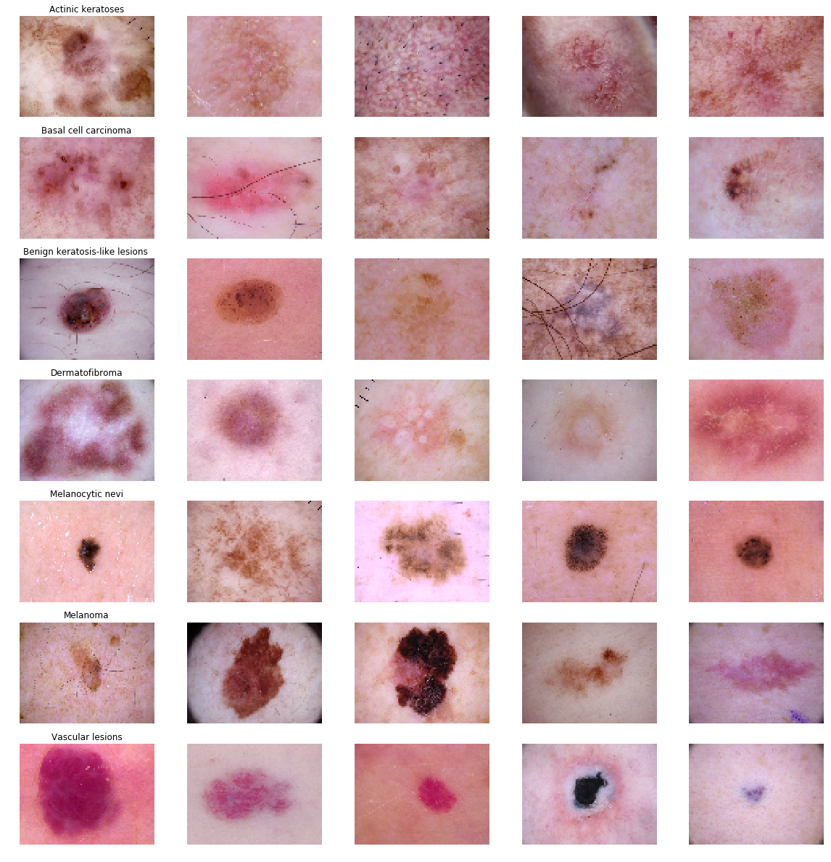
Skin cancer - 7 classes

Slide 13
Project work
Groups of two students - selforganized
Project report
Counts 30% of final course mark (written exam 70%)
We will offer 1-2 suggested tasks from each of the three EDC areas.
Each group should choose one task
The course responsibles may have to ‘’modify’’ group organization and/or task choices…

Slide 14
Lecture plan
Week 2A-2B : Introduction and basic statistics (refreshing …)
Week 3A – 6A: Estimation
Week 6B – 8B : Detection
Week 9A – 11A : Classification
Week 11B : Project description
Week 12A -14B : Project work
Week 15A – 15B : Excursion
Week 16A – 17A : Easter
Week 17B : Summary + Q&A
Week 18A-18B : Project work and Report deadline

Slide 15
Some final comments …
Nearly new course.
From three to one compendium/lecturer =>
Different presentation methods and exercise forms
The course is also new to the course assistants
Hopefully 1-2 student assistants
We therefore will very much appreciate:
A reference group (mandatory – NTNU diploma)
Feedback on compendium layout and contents
Feedback during lectures
Feedback on project tasks

